Slide 1
Process Induction Training
Process : Tokou
Name : ALVIN ANAK SAMAIL
Staff ID : 25029
Date : 24/11/2025

Slide 2
1) Objective & Introduction
Training Objective :
The process of coating slurry into the PET film to produce thin layer of ceramic sheet known as ‘green sheet’.
Process Overview:
Tokou process flow.
Material and machine.
Safety precaution and procedure.

Slide 3
2) Process Flow: Step by Step
SLURRY (HAIGO)
TANK & DIE COATER
PET FILM
TOKOU PARAMETER SETTING
COATING
DRYING
GREEN SHEET
INSPECTION
WRAP ROLL

Slide 4
2) Process Flow: Step by Step
TOKOU
Slurry (HAIGO) Receive slurry from Haigo in Tokou tank.
Slurry Tank, Die Coater and PET Film Preparation of tank die coater and connector. Ex : slurry, die coater, filter, PET Film.
Tokou Parameter Setting Machine preparation. (5 zone/Super high grade 5 zone)
Coating Test coating for roll. Coating sheet adjustment.
Drying Setting parameter humidifier machine.
Green Sheet Setting futec machine.
Inspection Test for green sheet weight and thickness.
Wrap roll Wrap roll and make indication. Keep roll at rack.

Slide 5
2) Process Flow:
a)Raw Material :
Slurry
PET Film
b)
Equipment | Machines
Die coating | 5 Zone (F6)
Futec | Super High Grade 5 Zone (F4)
Gear pump | High Grade 8 Zone (Normal Type) (A1)
 | High Grade 8 Zone (Wide Type) (A1)
c)Inspection Equipment / Tools:
Electric Scale – Measure density
Film thickness meter – Measure Thickness
Hybrid anemometer -
X-ray thickness gauge – Measure Thickness

Slide 6
3) Key Learning & Observation:
a)
Safety | Description
PPE | Safety glove, charcoal mask, hand glove, safety helmet, anti-fog spray, resistant glove.
SDS | CEA-H136 (5S)
WOI | D23MLMCMA32-AX01 OI : MLCCMS00000833
b)Environment Related:
Schedule waist only for chemical product
Operation environment :
Environment | Description
Room temperature (°C) | 23±7
Room humidity (%) | 65±1
Room ventilation | Inside local exhaust duct wind speed ≥ 5 m/sec
Degree of cleanliness | 3000 & below

Slide 7
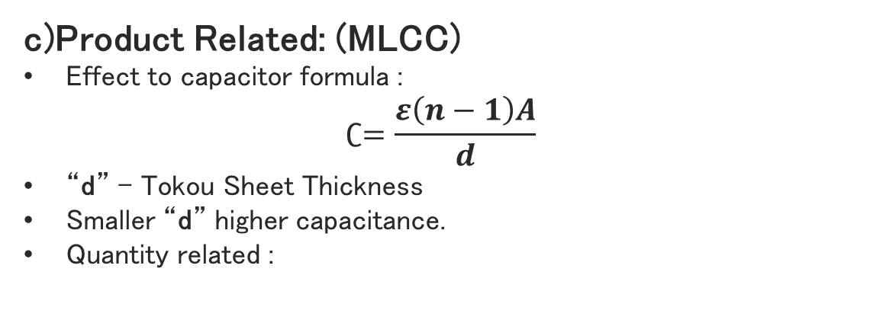
3) Key Learning & Observation:
c)Product Related: (MLCC)
Effect to capacitor formula :
$$∁=\frac{ε\left(n−1\right)A}{d}$$
“d” – Tokou Sheet Thickness
Smaller “d” higher capacitance.
Quantity related :
NG Mode | Cause | Prevention
Pinhole | Foreign leftover at the roller | Clean the roller properly
Clear line | Foreign material inside | Clean room control
Hajiki | Die coating clean not properly | Clean a die coating with solemix ap-17
Haigou→Tokou
Good Slurry | Less than 4 hour.
Good Slurry | More than 4 hour. Must re-Despa to use again.
NG Slurry | More than 48 hour. Issue NCIS.

Slide 8

4) Challenge & Improvement
Challenge | Cause
5 Zone machine speed are slower. | Due to limited zone. Short way to dry.
PET Film are change manually | Does not have machine judgement
Thickness Futec Machine and Electric scale (comparison) | This both machine still need human judgement.
How Tokou process effect?
Improvement
Machine : High grade 8 zone, PET Film auto change
System : Tokou Electric-Futec Tickness System
Special Characteristic : Sheet Weight (#)
Ceramic body
External Electrode
Internal Electrode
Internal Layer Sheet (Bati$O_{3}$)

Slide 9
5) Conclusion
The Tokou process conclude that chemical slurry forming a green sheet into the next process. This green sheet also as a COVER or LAYER for the MLCC. Therefore, Tokou process are important of 1st stage of forming a layer of the chip. Finally, in stack layer of this green sheet is basically concept of our MLCC.

